Slide 1

Financial Transaction Data Analysis Report
Made By : Ahmed Hossam Abd El Aziz

Slide 2
Presentation Agenda
This presentation will cover the essential steps and insights derived from our financial transaction data analysis.
1
Introduction & Objectives
Setting the stage for our analysis and outlining key goals.
2
Dataset Overview & Tools Used
A look at our data sources and the technologies enabling our analysis.
3
Data Preprocessing
How we prepared the data and solved its problems.
4
Business Analysis
Translating data findings into actionable business intelligence.
5
Dashboard Overview
Demonstrating our interactive visualisation of key metrics.
6
Conclusion & Recommendations
Summarising our findings and suggesting future strategic directions.

Slide 3
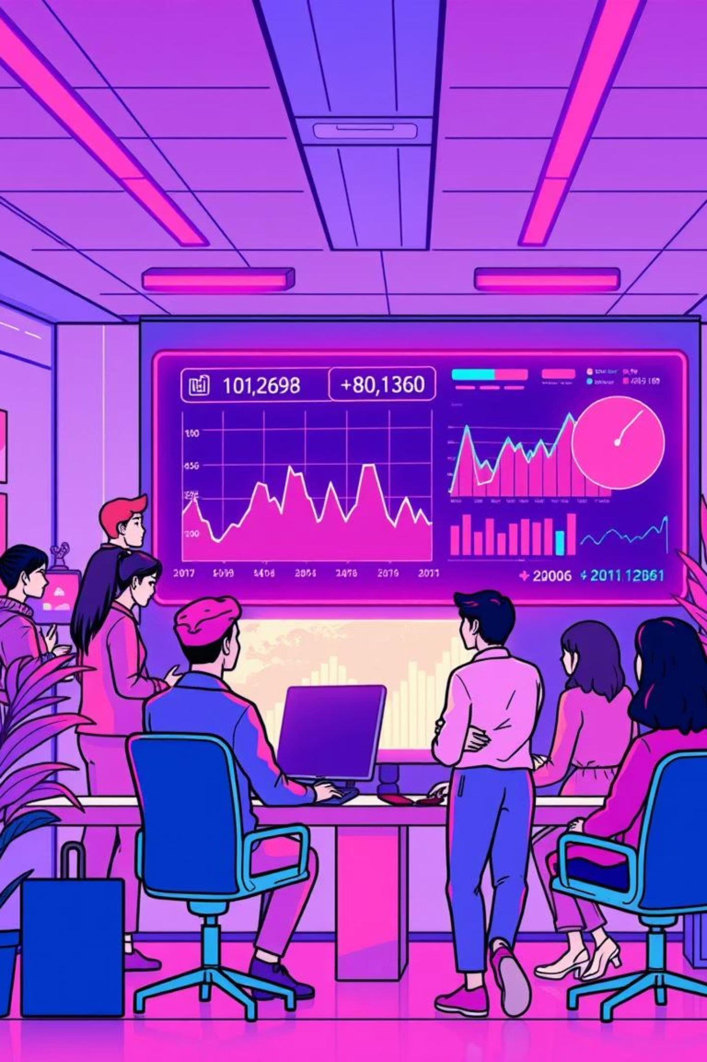
Introduction
Today, I will walk you through an analysis of a transactions dataset, where we explore customer behaviors, transaction patterns, and card usage trends.This project combines data cleaning, Python exploratory insights, and interactive Power BI dashboards to extract meaningful business insights.

Slide 4







Objectives
Understand Spending Trends
Evaluate Transaction & Card Usage
To understand spending trends across time, gender, and age groups.
To evaluate transaction types and card usage patterns.
Identify Customer Demographics
Visualize Insights with Power BI
To visualize insights using Power BI dashboards for clearer business decision-making.
To identify customer demographics driving the majority of spending.
Provide Recommendations
To provide recommendations that support growth strategies, enhance customer engagement, and increase digital adoption.

Slide 5
Dataset Overview
The dataset consists of 450,000 transactions with the following key attributes:
Transaction details: Amount, type (swipe, chip, online), and date.
Customer demographics: Age, gender.
Card details: Card type (debit, credit, prepaid), brand (Mastercard, Visa, Amex, Discover), and chip-enabled status.
Aggregated metrics: Total spending of $19.26M with an average spend of $42.80 per transaction.

Slide 6
Tools Used
Python
Power BI
Excel/CSV
SQL
Used for data cleaning, preprocessing, and exploratory insights.
Used for creating interactive dashboards that summarize key findings, offering dynamic data exploration and reporting capabilities.
Utilized for raw data handling and initial exploration, ensuring accessibility and preliminary data review.
Applied for efficiently querying structured subsets of the data, preparing it for further analysis.

Slide 7
Data Preprocessing
Data Cleaning
Handled missing values of "merchant_state" column with "Online" value
Convert the data type of "date" column to "Date" instead of "DateTime" to easily use it in the analysis
Removed the dollar sign($) from the values and Fixed the data type of "amount" column to be "float" and
Extracted new features such as year, month, and age groups for analysis.

Slide 8
















Business Analysis
From the insights, several business observations emerge:
Spending by Gender
Transaction Types
Card Usage
Almost balanced between males and females, ensuring wide market engagement.
Traditional swipe and chip dominate, while online transactions remain underutilized.
Debit cards are the most common, but credit cards drive higher spending.
Card Brands
Number of Cards Held
Spending Trends Over Years
Mastercard and Visa dominate the market; Amex and Discover have minimal usage.
Customers with 3–4 cards contribute the most spending, peaking at $4.9M.
Spending trends over years revealed steady growth until 2016, followed by a decline in recent years.
Monthly Spending Trends
Age Distribution of Customers
Monthly trends showed seasonal peaks around March, August, and October.
Age distribution highlighted that customers over 60 are the most active group, while younger customers are underrepresented.

Slide 9
Power BI Dashboard Overview
I designed three dashboards to visualize these findings clearly:
Overview Dashboard:
Displays total spending, average spending, transaction volume, and age statistics.
Highlights spending trends across years and months.
Customers Dashboard:
Shows spending and transaction distribution by gender.
Breaks down transaction types and customer age groups.
Provides insights into customer engagement patterns.
Cards Dashboard:
Analyzes card type usage (debit, credit, prepaid).
Shows chip card adoption rates.
Highlights card brand distribution and spending by the number of cards held.

Slide 10
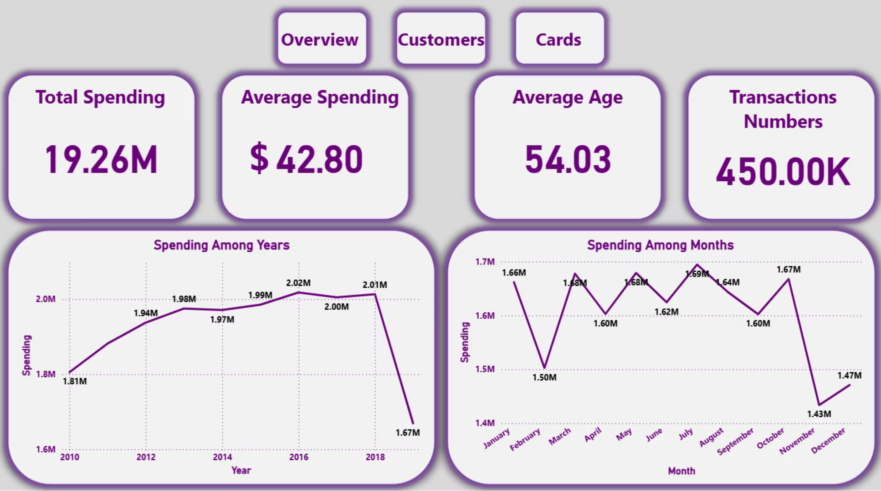
Overview Dashboard:

Slide 11
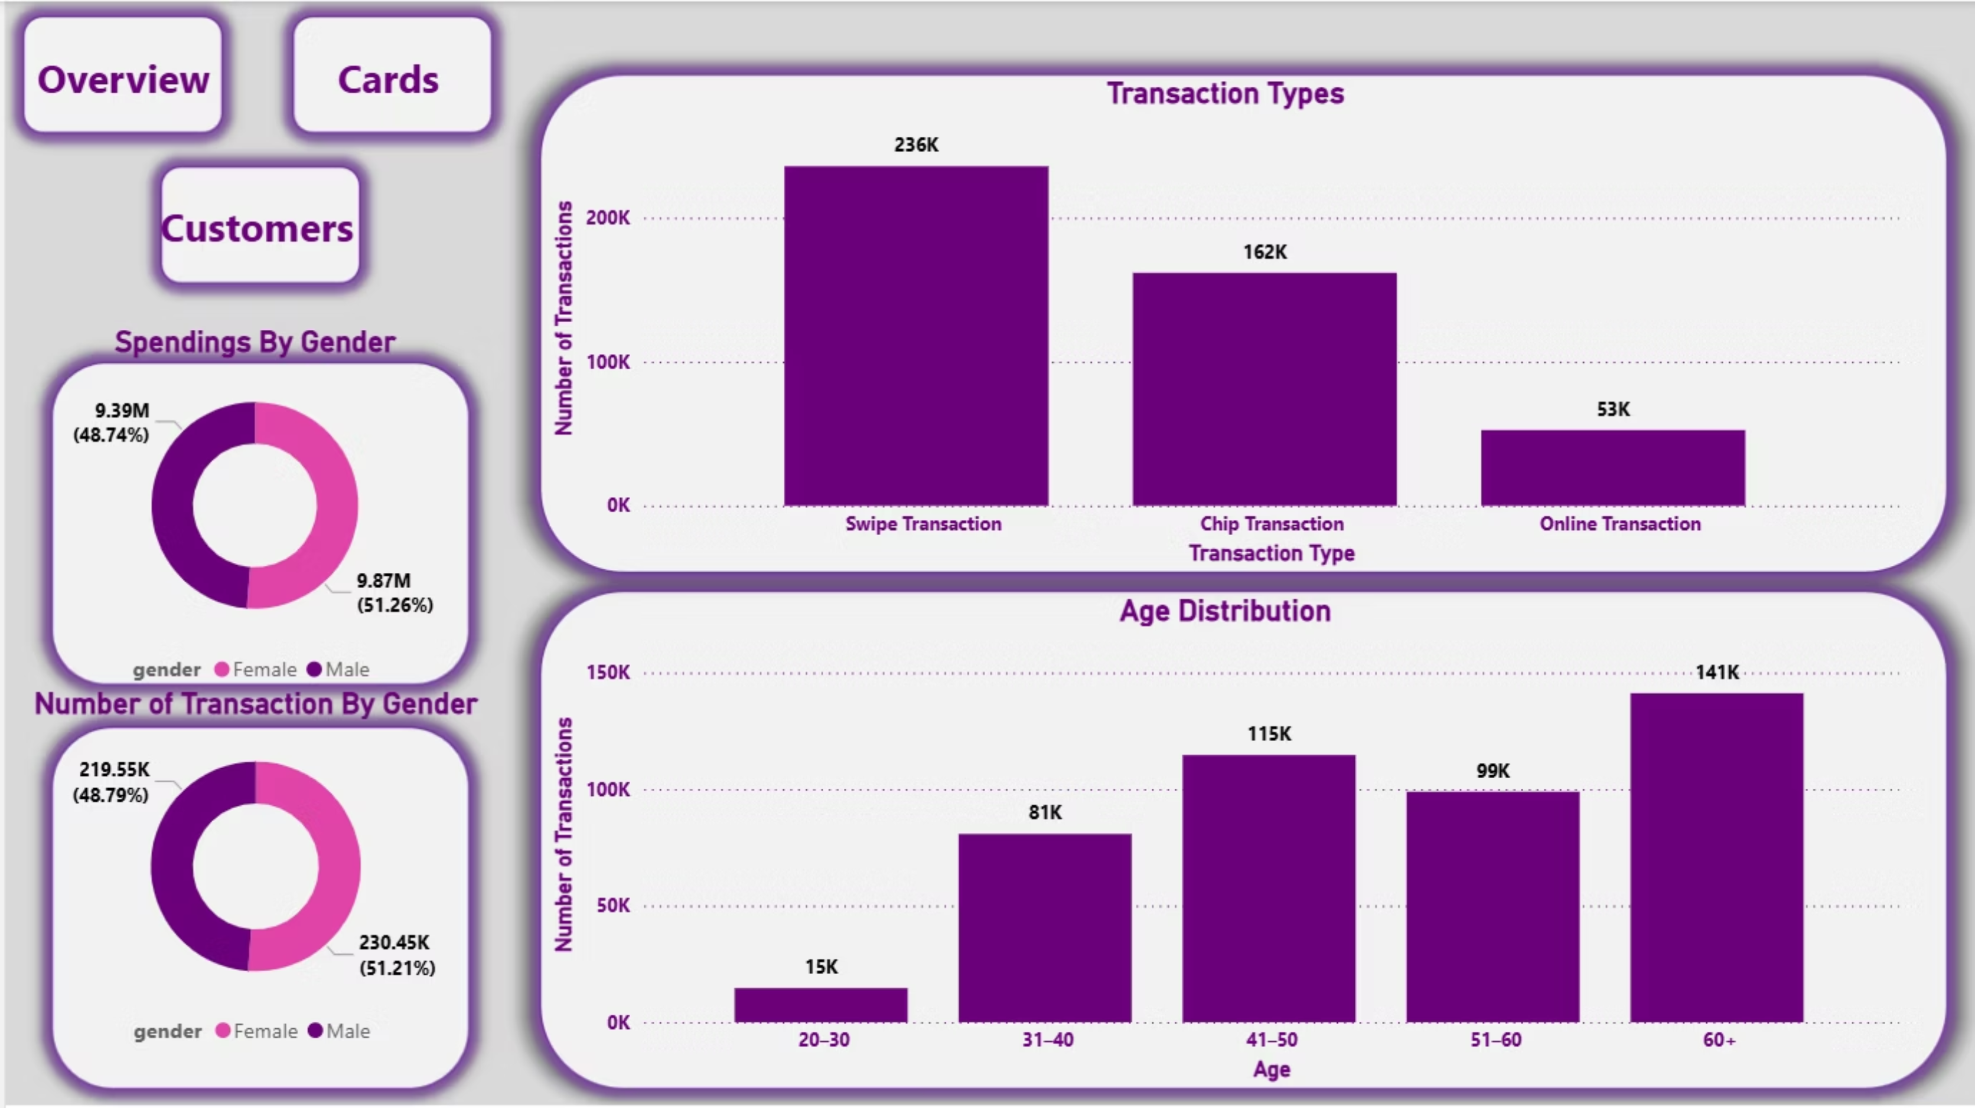
Customers Dashboard:

Slide 12
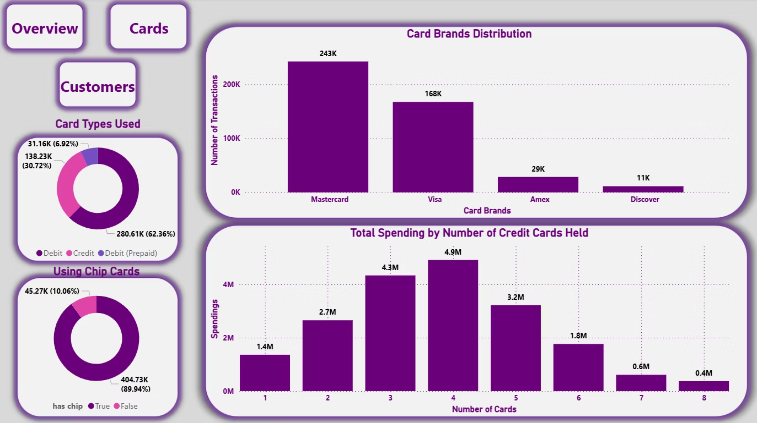
Cards Dashboard:

Slide 13
Conclusion
Total Spending & Transactions
Customer Spending Patterns
Transaction Types
The dataset reveals $19.26M in total spending across 450K transactions.
Spending is evenly distributed between genders, but older customers dominate in volume.
Swipe and chip transactions are the most common, while online transactions are still minimal.
Card Usage
Customer Value
Debit cards are most widely used, though credit card holders tend to spend more.
Customers with 3–4 cards provide the highest business value.

Slide 14
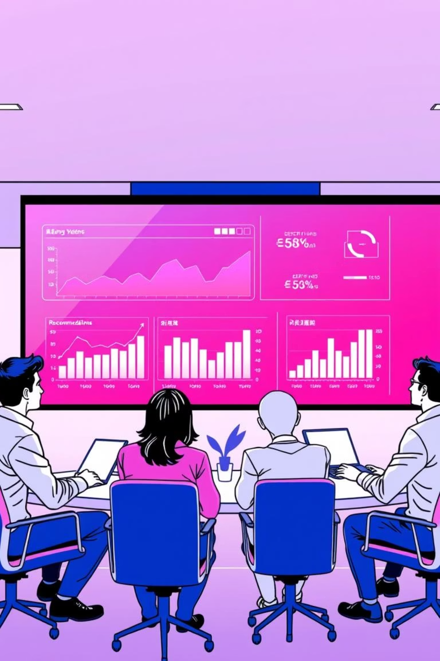

Recommendations
Based on the analysis, here are actionable recommendations:
Target Younger Customers (20–30 years)
Create youth-focused campaigns to capture the underrepresented segment.
Promote Online Transactions
Offer incentives for e-commerce or mobile payments to boost digital adoption.
Loyalty Programs for Multi-Card Holders
Customers with 3–4 cards are the most profitable—tailor loyalty benefits toward them.
Strengthen Partnerships with Mastercard & Visa
Since these brands dominate, exclusive offers or collaborations could drive even more usage.
Focus on Senior Customers (60+)
This age group is highly active; personalized services or simplified digital experiences could further increase engagement.

Slide 15


